Slide 1
Data Analysis & Visualization
Energy Consumption

Slide 2


ENERGY CONSUMPTION DATA ANALYSIS
PROCTER : MRS. ASHWINI
PRESENTED BY: SHRAVANI M B
MANASA R
SUDANSHU

Slide 3
Table of contents
01
02
03
04
Exploratory Data Analysis
Outlier Detection and Handling
Unveiling Insights through Data Cleaning and Manipulation
IQR Method and treatments for handling.
Analysis with Excel & Mysql
Analysis & Dashboard with Power BI
Unlocking Insights: Data Analysis and Trend Analyis, what if Anlysis
Interactive Power BI Dashboard for actionable insights.

Slide 4

Aim:
To analyze urban energy consumption patterns to optimize resource allocation and enhance sustainability
The primary objective of this analysis is to delve into the trends and patterns within the dataset, uncovering correlations between energy production, consumption, population dynamics
Objective:

Slide 5
Key features of the Dataset
Energy Production and Consumption Metrics:
The dataset includes key metrics such as coal, gas, and oil production changes, energy consumption patterns, and biofuel utilization, and consumption worldwide
Renewable Energy and Environmental Indicators:
Metrics related to renewable energy sources, including their share in electricity generation and consumption
Population and Economic Metrics:
Population data and gross economic product [GDP] figures provide context for understanding the socioeconomic factors influencing energy demand and consumption patterns across different regions

Slide 6
Preface:
This Project titled “ Energy Consumption- Data Analysis & Visualization ” represents the culmination of extensive research aimed at understanding the role of Various forms of Energy Consumption & Production in promoting sustainable urban environments. The motivation behind this work stems from the growing urgency to address the change and the need for sustainable development solutions in urban areas.
Throughout the course of this project, we have explored various dimensions of various forms of energy adoption, including its economic, demographic, time series and social impacts on urban sustainability.

Slide 7
Environment Setup
There are various approaches for setting up an environment for Data Analysis and Data Visualization. Some of them are:
Approach | Purpose
Google colab | Exploratory Data Analysis (EDA)
MySql | Advance Analysis, Exploratory Data Analysis (EDA)
Ms Excel | Data Analysis & Visualisation
Power BI | Data Visualisation

Slide 8
01
Exploratory Data Analysis
Data preprocessing

Slide 9

Data Cleaning
Imported are some of the packages like pandas, numpy, matplotlib and seaborn for data analysis and data manipulation
Pandas for Data Analysis
Numpy for Numerical Operations
Matplotlib and Seaborn for Data Visualisation.
Read the CSV file into a DataFrame, & replaced 'your_file.csv' with our path to your CSV file.

Slide 10

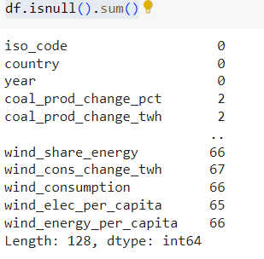
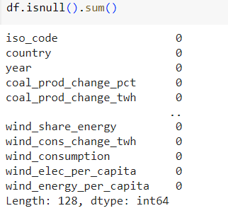
It is to be known that this dataset has 300 rows × 128 columns as determined by using df.shape
Checked for the Duplicate values, but none were found.
Utilised df.describe() to get the Statistical Summary.
Checked for the Missing values, missing_values = df.isnull().sum()
Replaced NAN into empty( blank space)df = df.fillna(‘’)
Missing Values % were calculated by using null_percentage = df.isnull().sum() / len(df) * 100

Slide 11
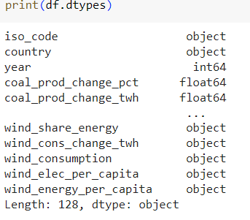
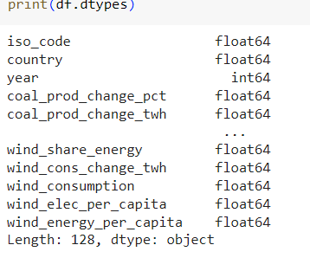
Converted data type from objective to int by using df = df.apply(pd.to_numeric, errors='coerce’)
To fill the null values, the median for each column was find out by using median_values = df.median(), print("Median values for each column:")
print(median_values)
Filled that median columns into the dataset by using df.fillna(median_values,inplace=True)
The same process repeated for all 3 data sets

Slide 12

Data Integration

Slide 13
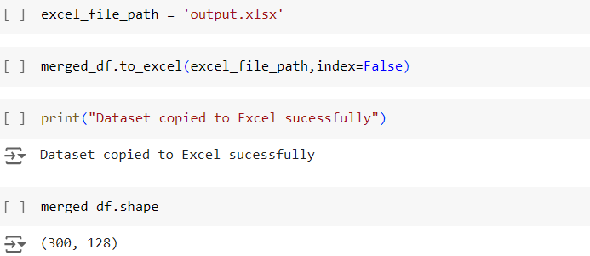

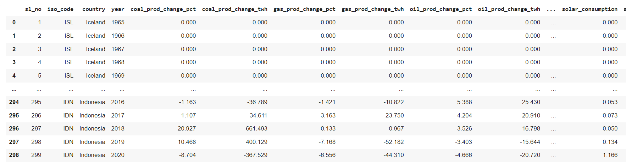
Exported that data set to excel by using excel_file_path = 'output.xlsx’, df.to_excel(excel_file_path,index=False), print("Dataset copied to Excel sucessfully")

Slide 14
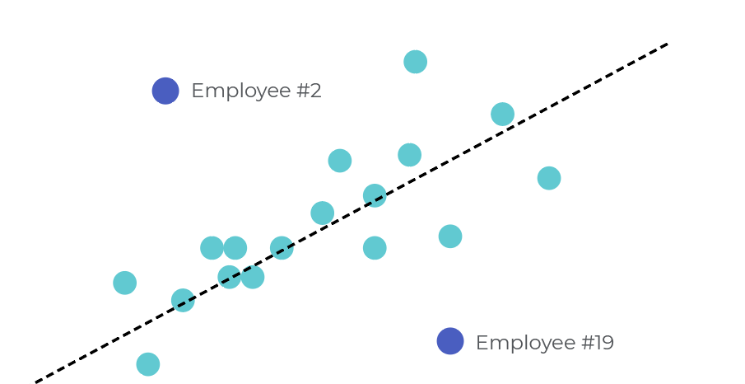
02
Outlier Detection & Handling
On the column ‘quantity’.

Slide 15
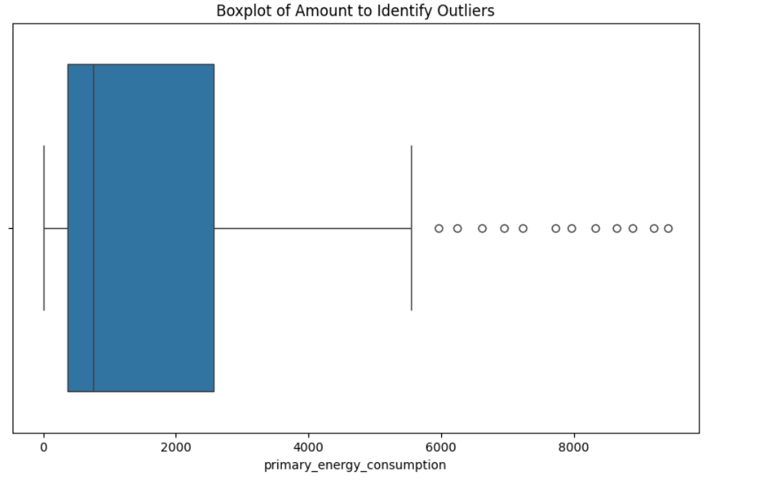
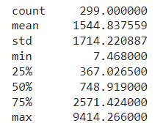
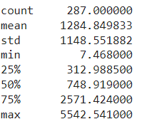
Outlier Detection
Python was used to detect the Outliners
Box-plot is used to visually detect the outliers.
Getting the outliers using IQR method where quantile of Q1 is set to 0.25 and Q3 is set to 0.75.
Total no. of outliers: 12
Percentage of data loss: 1.05%
Before removing outliers:
After removing outliers:

Slide 16
Treatments to handle outliers
Trimming
Capping
Removing the outliers is straightforward & is often used when outliners are suspected to be errors
Capping outliners involves setting extreme values to a percentile to minimize their impact .
Transform (log)
Winsorization
Replace the outliers with log of itself.
Replace the outliers closer to the central part.

Slide 17
Statistics on Treatments
Method/Stats | Original | Trimming | Capping | Transforming | Winsorization
Records | 299 | 259 | 287 | 287 | 287
Mean | 1544.83 | 1206.87 | 1221.48 | 6.323 | 15.623
Std | 1714.22 | 967.27 | 1010.95 | 1.738 | 1.779
Max | 9414.26 | 2742.25 | 2700.50 | 8.620 | 15.624

Slide 18
GeoSpatial Analysis
Install and import Geopandas Library.
'Naturalearth_lowres' is map dataset which is built-in dataset provided by GeoPandas.
The map dataset is read and GeoDataFrame is formed which is then compared with the our DataFrame to plot map.

Slide 19
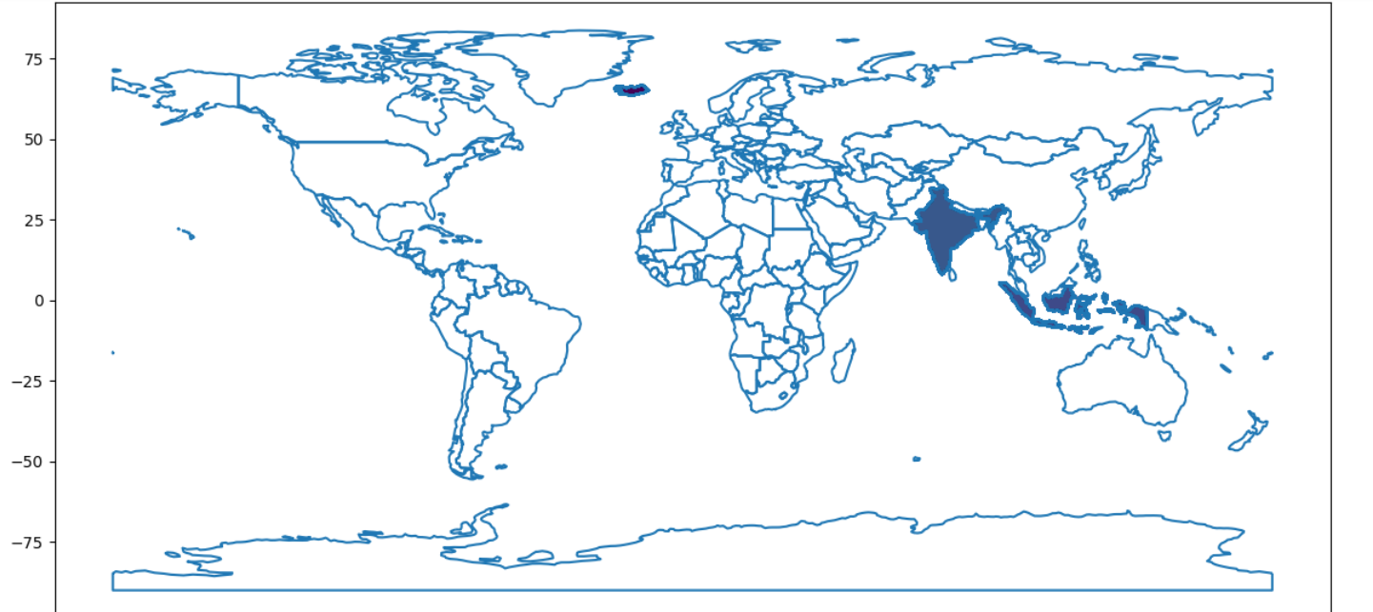
GeoSpatial Analysis
Primary Energy Consumption of countries was analyzed, as a result we found that India tops in the Energy Consumption

Slide 20
03
Analysis with Excel & MySql

Slide 21
Relationship between Energy Consumption v/s Electricity Demand
The above chart shows the Electricity demand and Energy Consumption in percentage by country wise
Where as India is in top place for the consumption and demand and both are directly proportional to each other

Slide 22
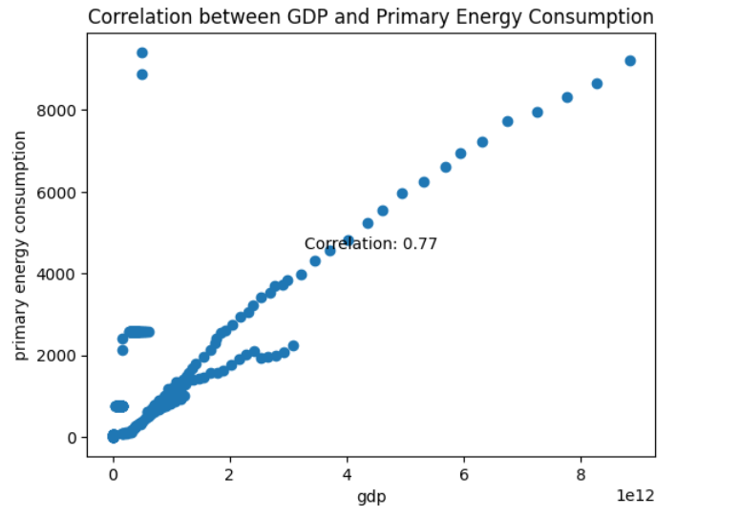
Correlation between GDP and Primary Energy Consumption
The graph shows a Positive Correlation between the GDP and Primary Energy Consumption

Slide 23
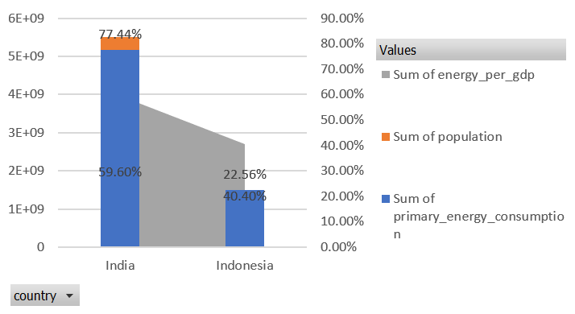
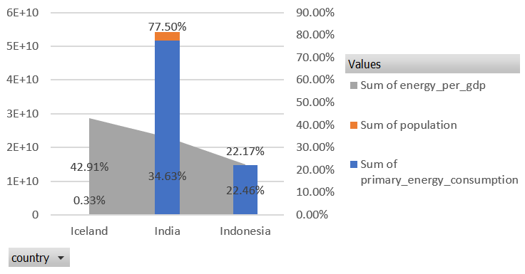
Trend Analysis: Quaterwise
Quarter 2
Quarter 1
The population count by country wise along with the primary energy consumption(all sources such as fossil fuels(coal,oil,natural gas), nuclear energy & renewable sources(solar, wind) and energy per gdp were taken to analyze the Energy Intensity that gives the insights into the energy efficiency and economic productivity of a country
In the Quarter 1 & 2 – Indonesia producing more economic output with less energy consumption and India is using more energy to produce the same amount of economic output

Slide 24
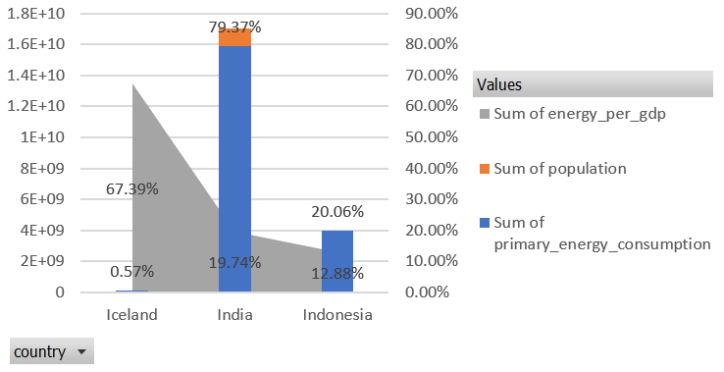
Trend Analysis: Quaterwise
Quarter 3
In the Quarter 3 – Iceland producing more economic output with less energy consumption and India is using more energy to produce the same amount of economic output
India has a lower energy per GDP ratio compared to Indonesia and Iceland, indicating that India is more energy efficient , producing more economic output per unit of energy consumed

Slide 25
04
Analysis & Dashboard with Power BI

Slide 26
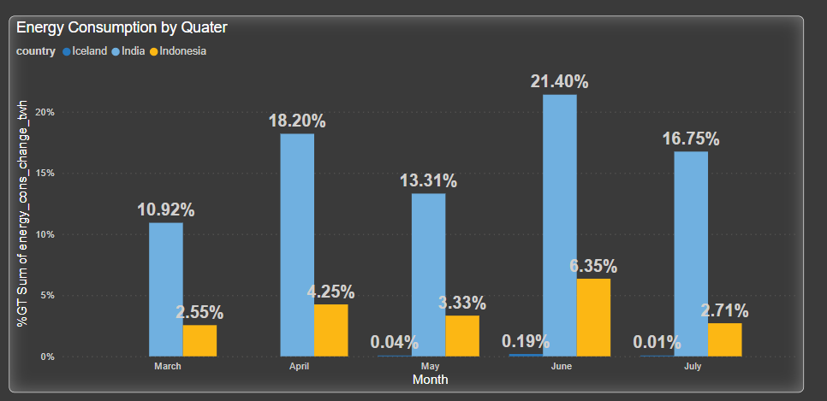
Energy Consumption - Month Type:
The Clustered Column chart illustrates the quantity of imports by month.
The Dataset contains the Energy Consumption between from March to July
In the month of June, the Energy Consumption % was more by the country India that is 21.40% and whereas the Iceland with 0.04% in the month of may

Slide 27
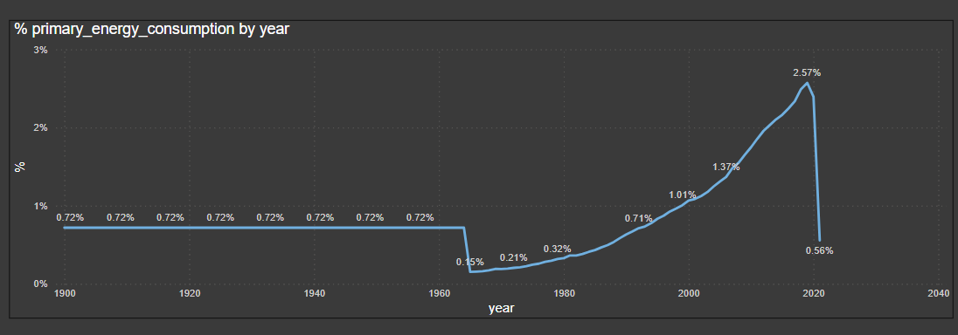
Primary Energy Consumption by Year wise
The Line chart illustrates the year wise primary energy consumption by % , Providing a visual comparisons of their respective imports volumes.
In the year 2019, has highest energy consumption with 2.57% whereas in the year 1965 has least energy consumption of 0.15%

Slide 28
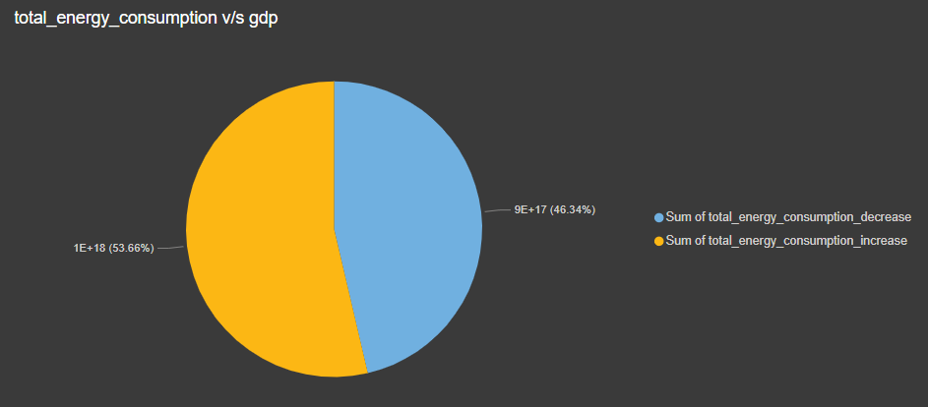
What if Analysis – Primary Energy Consumption v/s GDP
By using what if analysis in the MySql, the % of primary energy consumption with the increase of 10% gdp and with decrease of 5% gdp, the next year energy consumption were calculated and that data exported to Power Bi for the visualization
The sql query as below mentioned
Increase GDP by 10% SELECT primary_energy_consumption * (gdp * 1.1) AS total_energy_consumption_increase from final_energyyyyyyyy;
#Decrease GDP by 5%SELECT primary_energy_consumption * (gdp * 0.95) AS total_energy_consumption_decrease from final_energyyyyyyyy;
On the baseline of primary energy consumption, if the gdp decreases 5%, it will decreases upto 43% , where as if increase to 10%, then increase to 53%

Slide 29
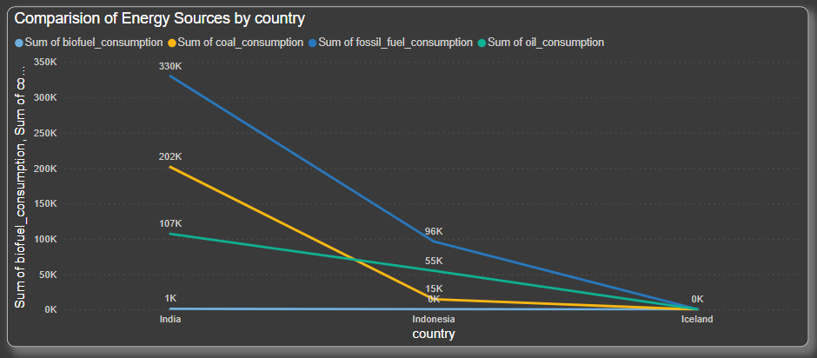
Comparision of Energy Sources Consumption by Country:
India has the highest biofueal, coal, fossil, oil consumpution where as Iceland has the least consumption

Slide 30
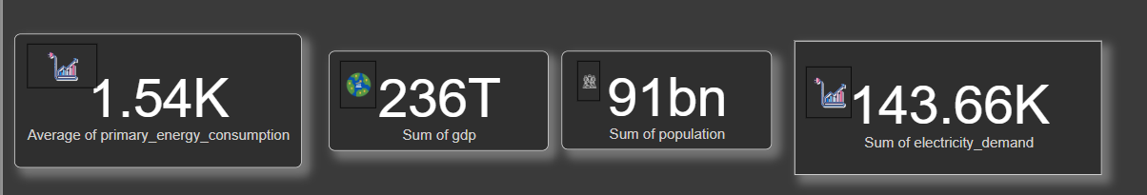
KPI’s :
Created a dynamic Power BI dashboard and reports to visualize key performance indicators (KPIs).
Created four KPIs. – Average of Primary Energy Consumption, Sum of GDP, Total Count of Population and Total Electricity demand over 3 countries India, Indonesia and Iceland

Slide 31
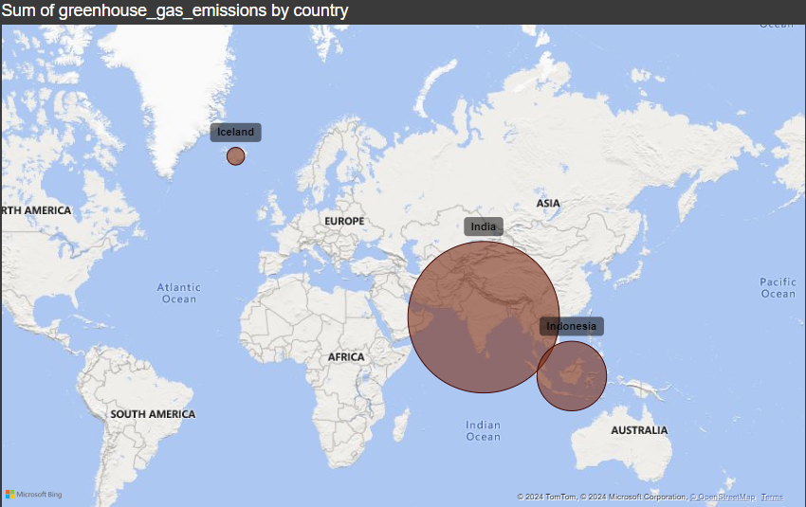
Greenhouse Emission by Country:
Used Power BI charting tools to create a map visualization.
In this map visualization plots on the ‘Greenhouse emission by Country’
Here the Pink bubble shows the area of highest consumption

Slide 32
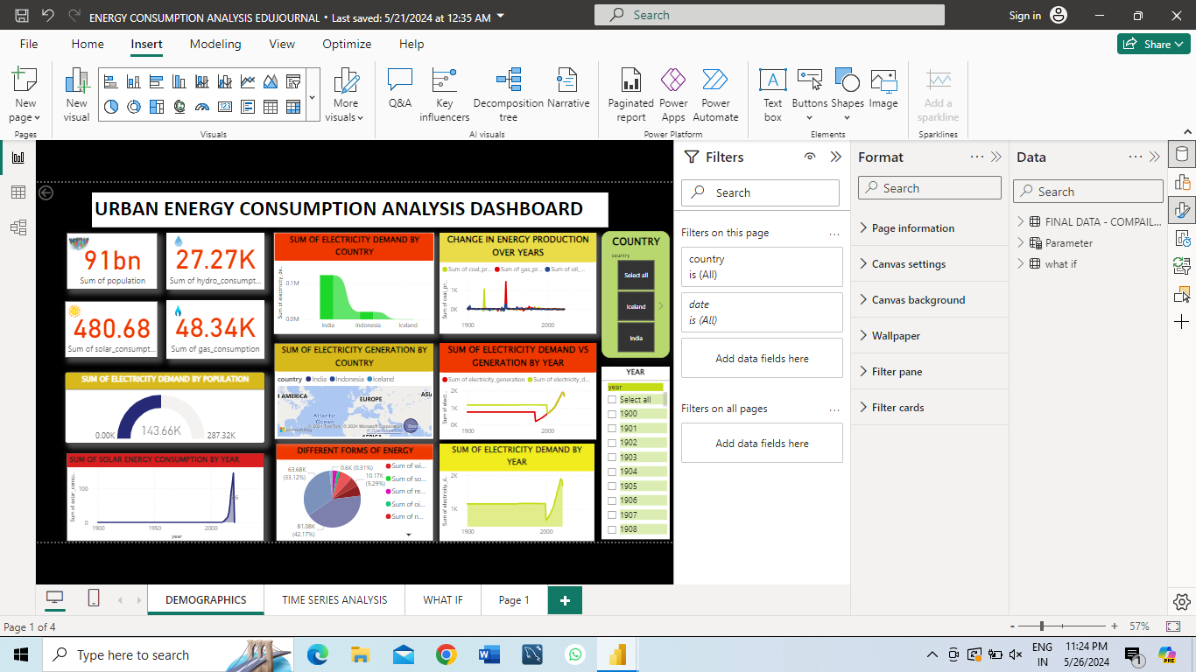
Final Dashboard

Slide 33
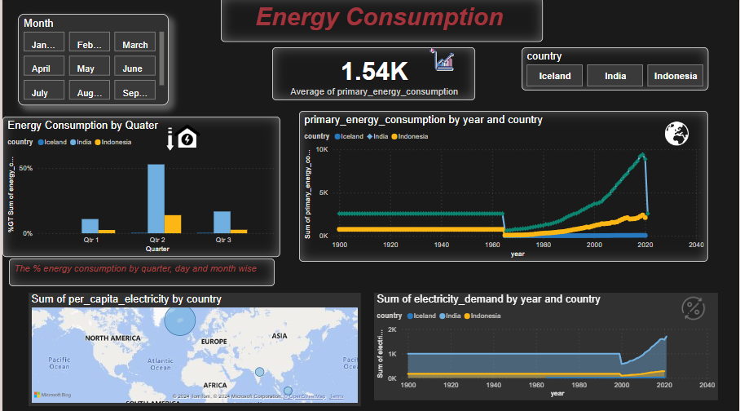
Final Dashboard

Slide 34
Conclusion
The Energy Consumption project provided valuable insights into urban energy consumption patterns.
This Analysis of Urban Energy Consumption patterns aimed to optimize resource allocation and enhance sustainability.
By using tools such as Google Colab, MySQL, Ms Excel, Power BI, the study identified key trends and correlations within the dataset.
Key findings like effective outlier detection, statistical insights into energy consumption patterns, and the correlation and trend analysis indicate significant differences in energy efficiency between India, Indonesia and Iceland

Slide 35
Reference
https://colab.research.google.com/drive/1xlYRPSKI1KtiJQcGqkZnLcWAIyhpSDbF?usp=sharing
https://colab.research.google.com/drive/10DZni0kld_fyKPKVmgVykNvCqnbQwxX9?usp=sharing
https://colab.research.google.com/drive/1jjfMwAwx-SNSmETWb4ijPUCmjHFdGSR2?usp=sharing
https://colab.research.google.com/drive/1jjfMwAwx-SNSmETWb4ijPUCmjHFdGSR2?usp=sharing

Slide 36
Thank
You!

